Slide 1
Make Academia Interesting
An approach made towards increasing the interests of students toward academics.

Slide 2
Team members
Rahul Kumar (cse160001047@iiti.ac.in)
(Leader, Back-end Designing)
Harsh Vardhan(160001025@iiti.ac.in)
(Back-end Designing)
Rishabh Kumar Verma(160001048@iiti.ac.in)
(Back-end Designing)
Rishabh Verma(160001049@iiti.ac.in)
(Front-end Designing)

Slide 3
Summary of project
The idea behind this project is to give students of common interests in academic fields a platform where they can share materials regarding their subjects to the students who are interested in that particular fields.
Students are mainly characterised based on which year and which particular branch they belong.
They can upload any file if it seems them to be shareable and to be beneficial to their peers.
Same applies for the other end ,if any student find something interested in any file then he/she can download the file.
If any student is going to upload a file then the other students who’ve allowed notifications to themselves ,are informed through mails to them.
(This part is quite useful ,in our sense ,as no one wants to visit the site regularly in order to see is there any new material available to them.)

Slide 4
Continuing…
Students can also see their peers group that how many and who are in member with group they are in.
They can view their profile and can upload their profile picture.

Slide 5
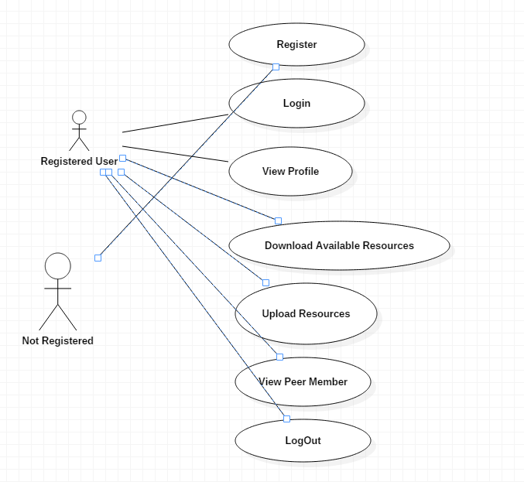
And the conceptual use-case?

Slide 6
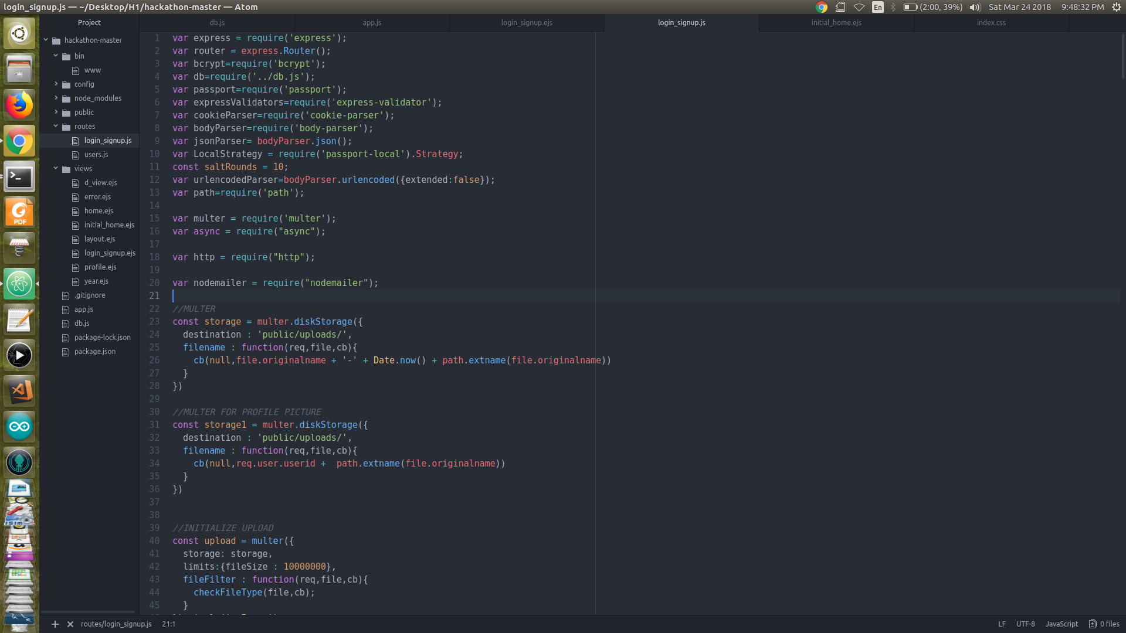
Few lines of code

Slide 7
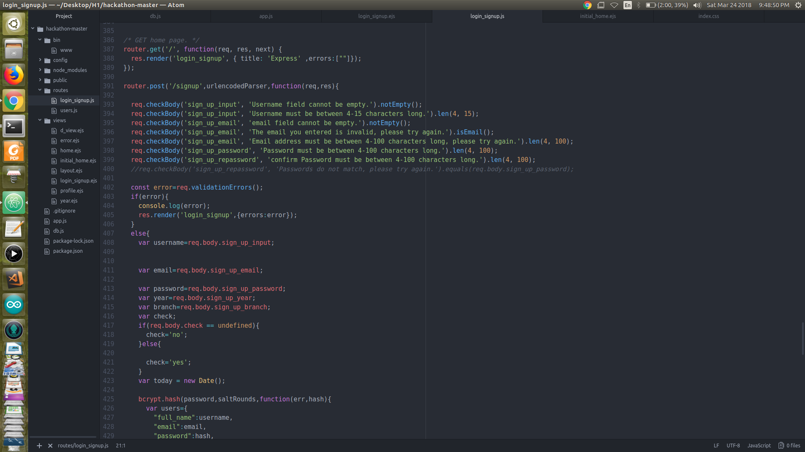

Slide 8

But what about the actual scene??

Slide 9
Here we go…

Slide 10
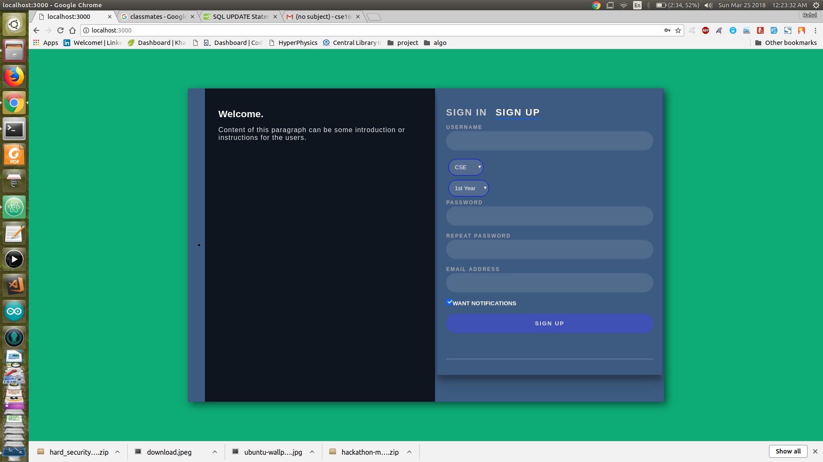
Signup Page

Slide 11
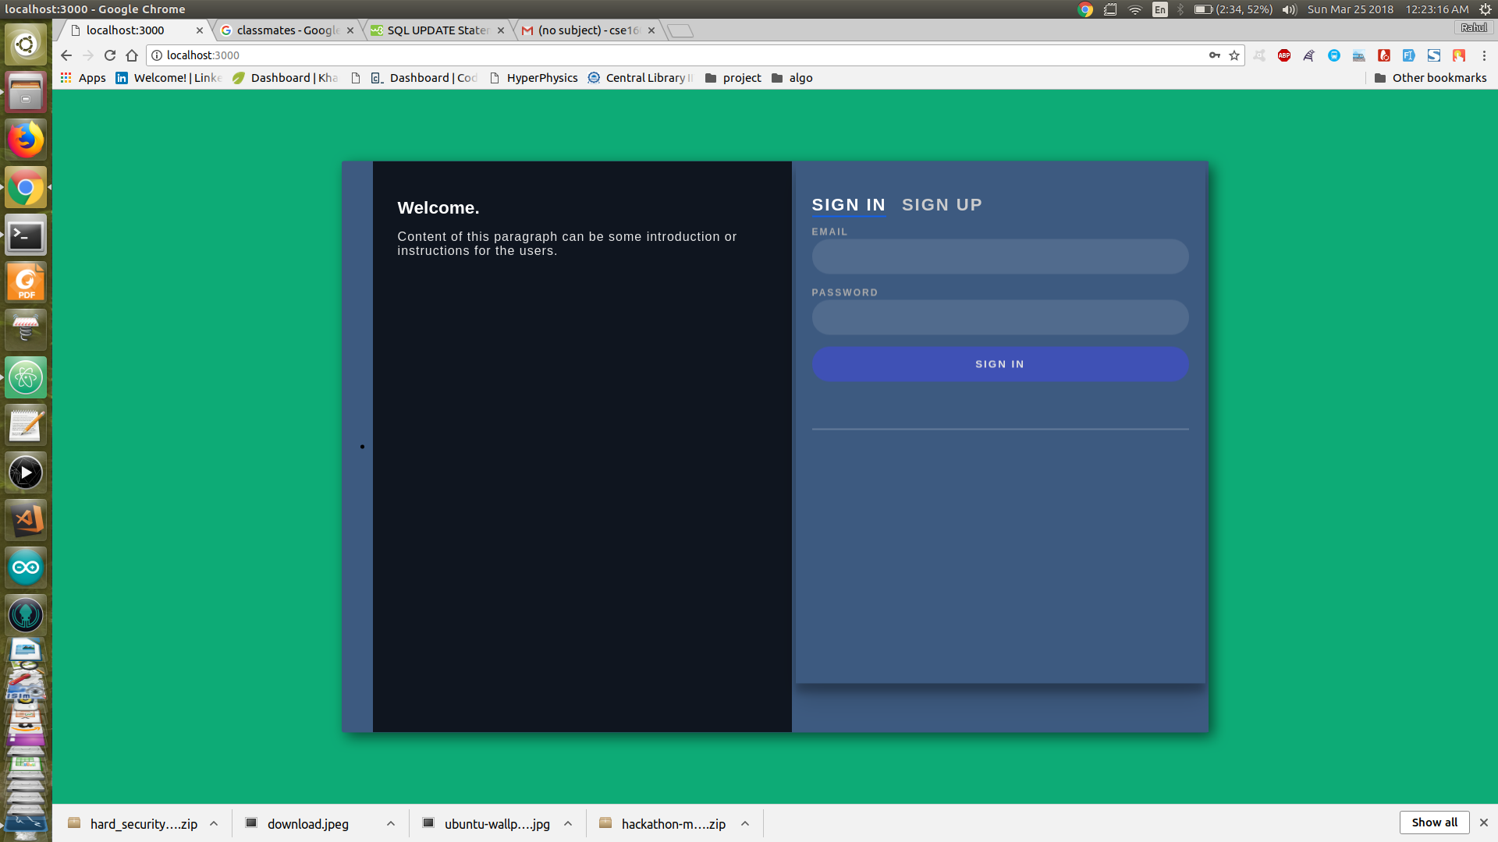
Login page

Slide 12
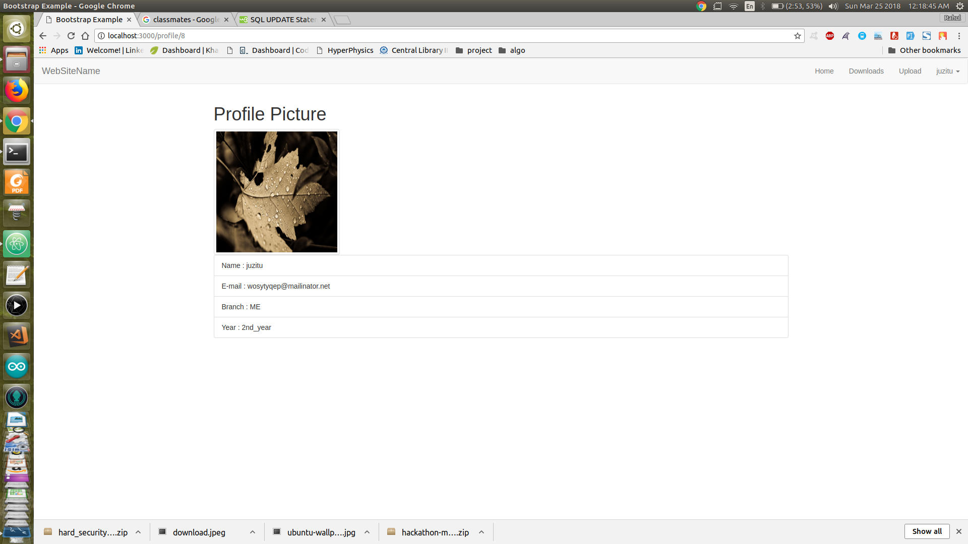
What after sign-up or log-in??
After signing up(for the new user) for the very first time or after logging in by an already registered user, user will be redirected towards a home page.

Slide 13
Functionalities of a user
Can see their Downloads till now.
Can upload a file of restricted types(pdf, docs ,zip ,jpg)
View profile of their group i.e ,students registered for that particular group

Slide 14
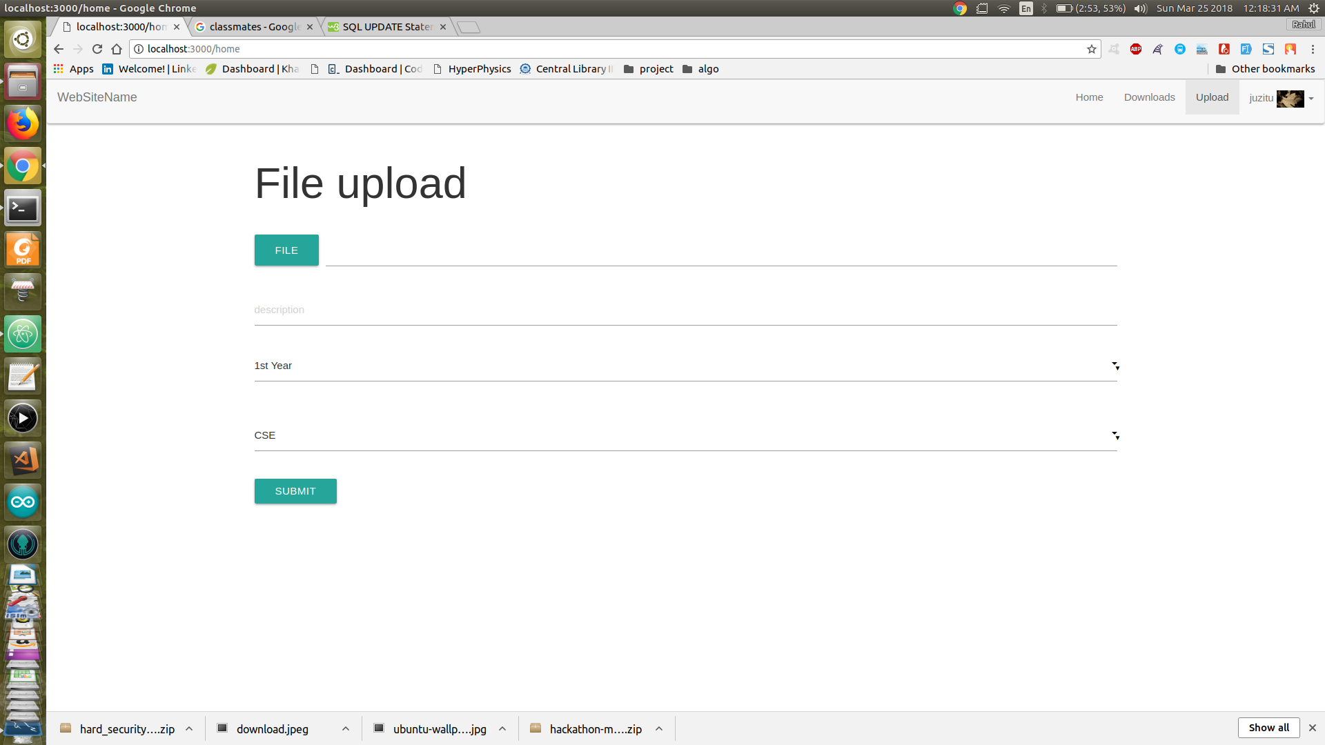
Selecting category for uploads

Slide 15
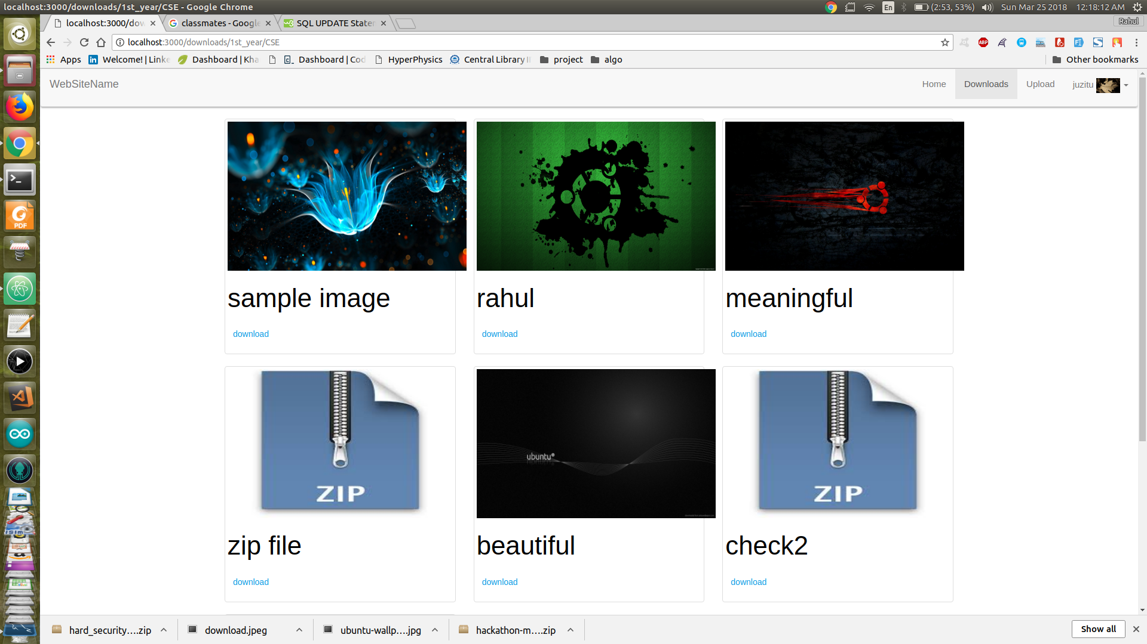
List of downloadables

Slide 16
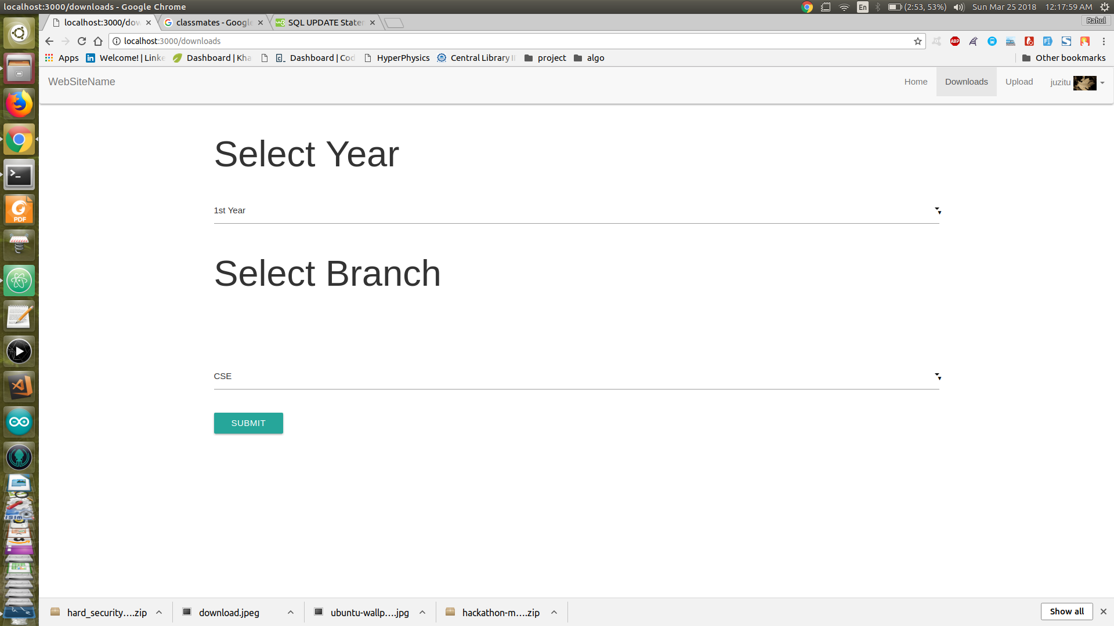
Selecting category for downloads list

Slide 17
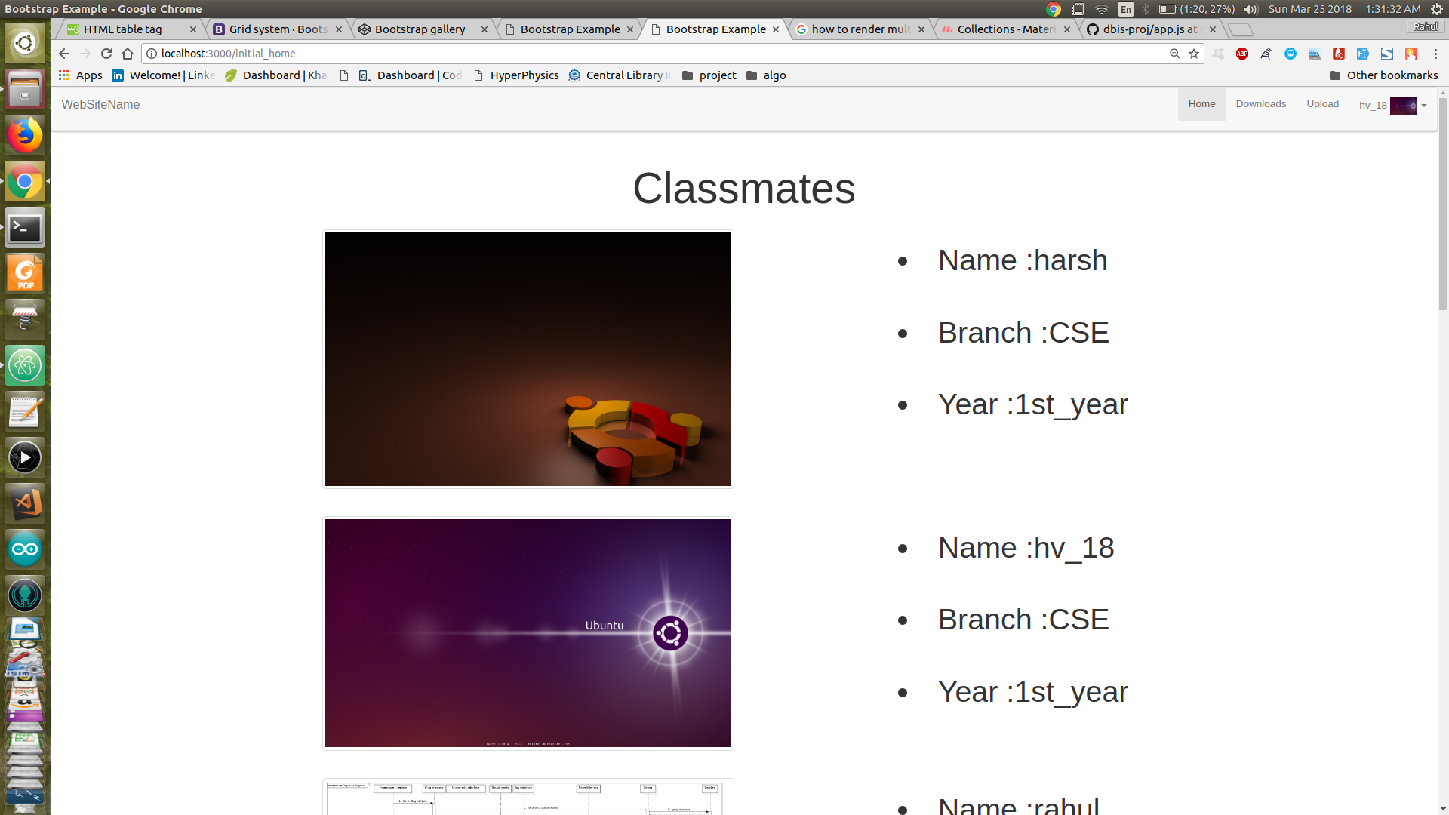
Classmates

Slide 18
Future potential of Such Concept?
In future we’ve thought to extend this project with some more features to users as compared to feature available now.
Features can be like these:-
A chat box can be arranged between juniors and their respective seniors to have some advice and suggestion on various academics related to topics.
Many students have problem of going to classrooms , with possible helps there can be a facility to organise a live video session of classroom.
Further modifications can be made to give website a better look and performance.
Categorisation of students can be extended later on with respect to various technical fields.

Slide 19
…Conclusion
Our goal is to connect students of common interests related to academic fields. After implications of various pre-thoughts the website can be a handy tool for better learning of students.
Any more suggestions or advices are welcomed to the feedback page of website(planned for implementing it later).

Slide 20
Good Bye

